Slide 1

Tells My Actions

Slide 2
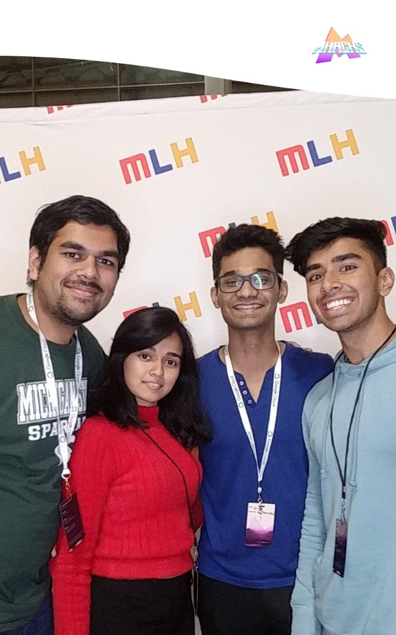
About Us
Hemkesh, Rujuta, Ninad and Sahil
(from left to right)

Slide 3

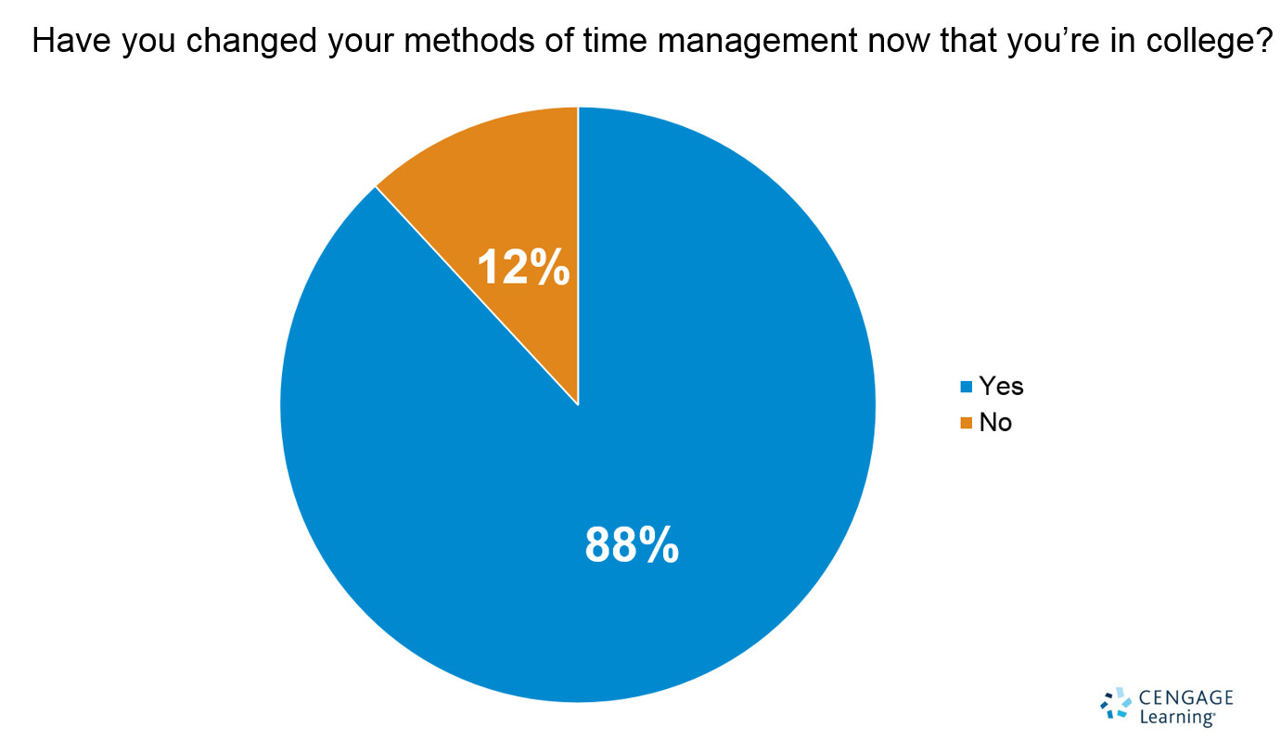
Problem statement
Depression caused due to ineffective time management skills, is making the students in this advanced developing generation weak. Mental health is the best solution for social good.
88% of the college students want to increase their ability to manage time but could not even get some time out to sit with their calendar. We wanted to address that.

Slide 4

Proposition
My Time Management Assistant (MyTMA)
Manages your time management keeping study and fitness as the focus.
An App to create effective calendars promoting productivity, social event culture and fitness.
It is aimed towards mental health, organisation and social good.

Slide 5
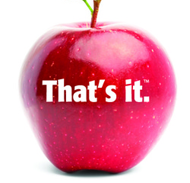
Pre Requisites
Existing google calendar for the class schedules
Rating 1-5 for fitness and study

Slide 6
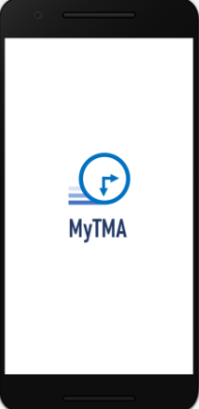
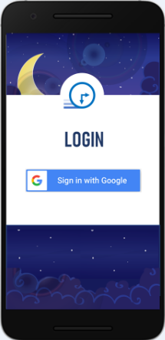
Demo
m

Slide 7
Features for the users
Helps keep the time allotted for fitness and study consistent.
Add events in the google calendar.
Cancel events form the google calendar.
Add events using the image of the pamphlet using ML.
Notifications of the reminders provided by the app.
Suggests nearby events.

Slide 8
Soft Skills used
Javascript
CSS
Python
Java
Machine learning (Google NLP)
Json
Firebase
Bootstrap
HTML

Slide 9
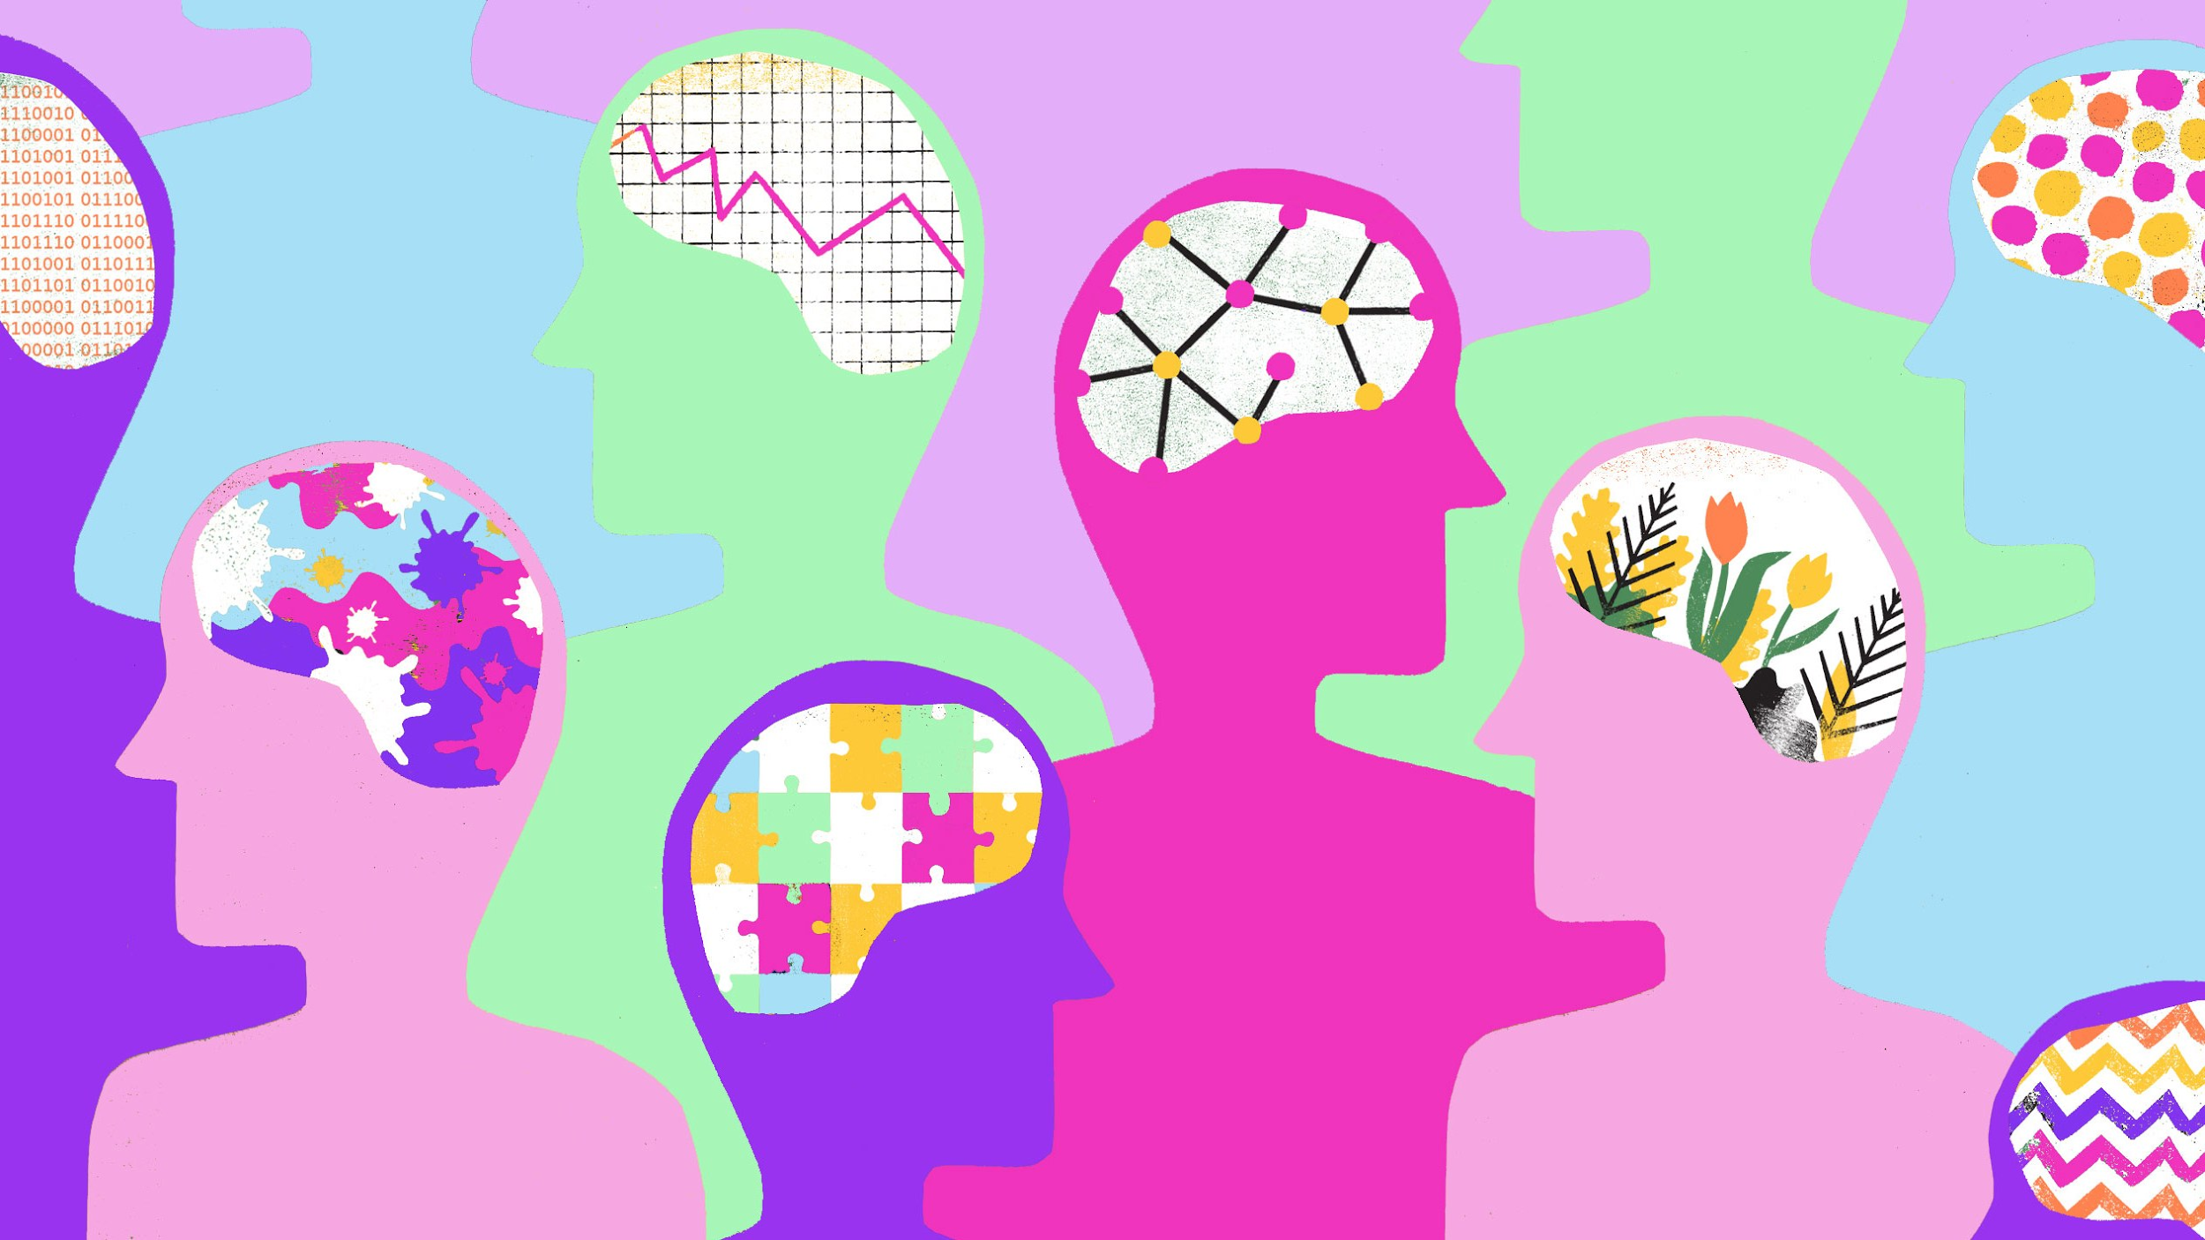
Social good
It would have a large scale impact on students to reduce their stress levels.
Auto time management and increased productivity.
Useful for other demographics as well for their hectic lives.
Promotes fitness and social event culture.
Uses machine learning to learn people’s habits and direct them towards the better path.

Slide 10
What’s next for MyTMA?
Suggest events using machine learning.
Voice recognition for scheduling events.
Make it more convenient for the user.
Weekly satisfaction surveys.
Reminders for eating, sleeping and fitness.
Extend the audience demographics.

Slide 11

Thank you
For taking out time from your busy schedules
(MyTMA could assist you too)

